Slide 1
.
Agentic AI Hackathon: Building Intelligent Agents with IBM Granite and LangFlow
Problem Statement 15: AI-Assisted Yield Trend Analysis and Farm Planning System

Slide 2
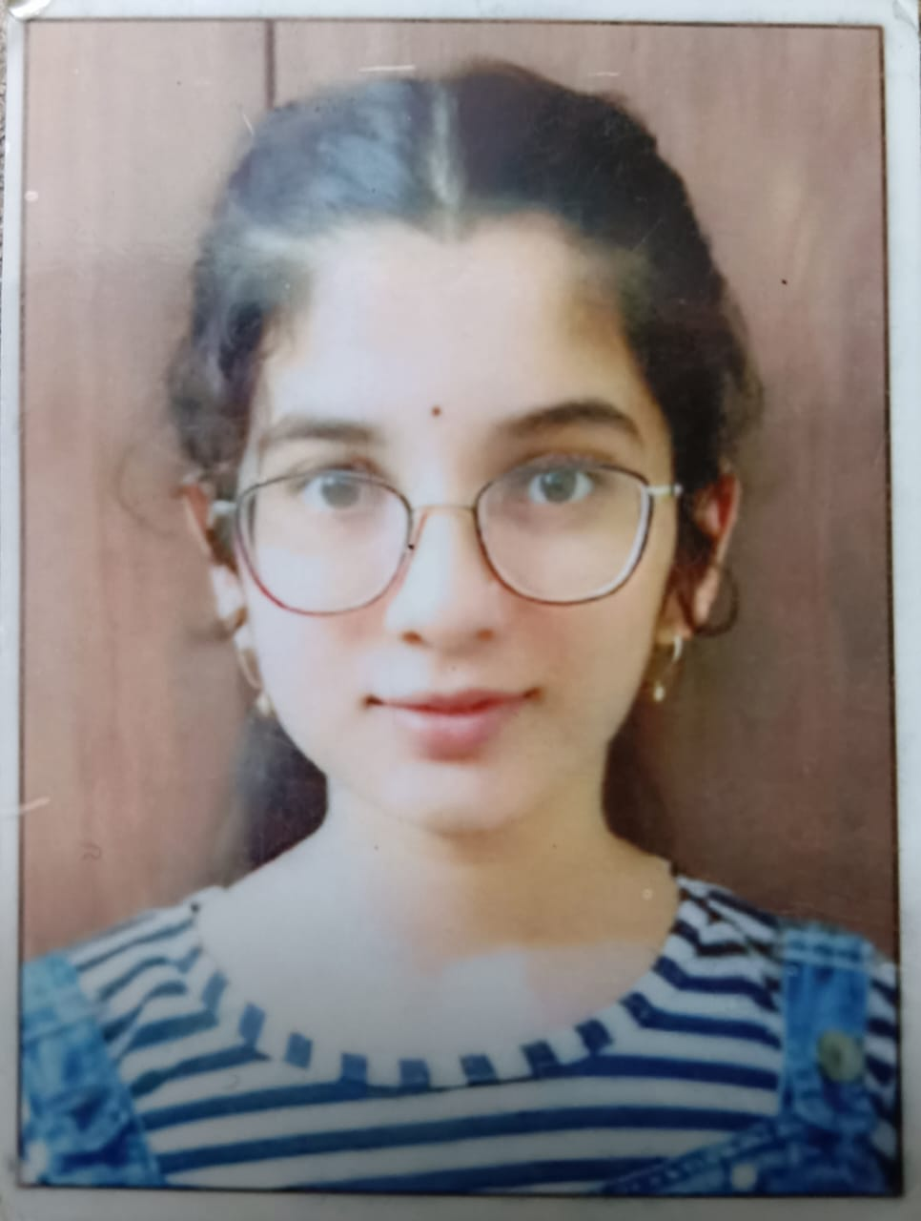
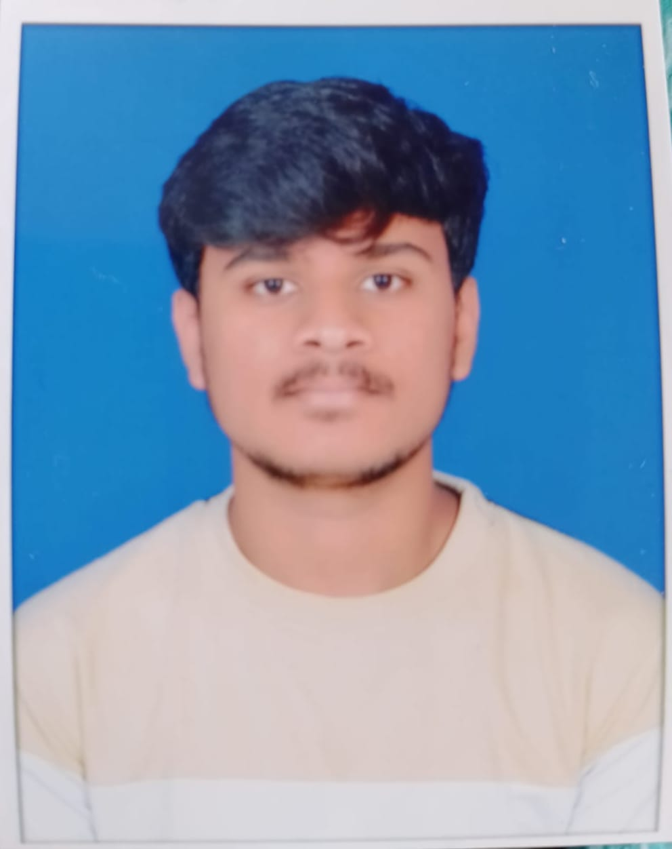
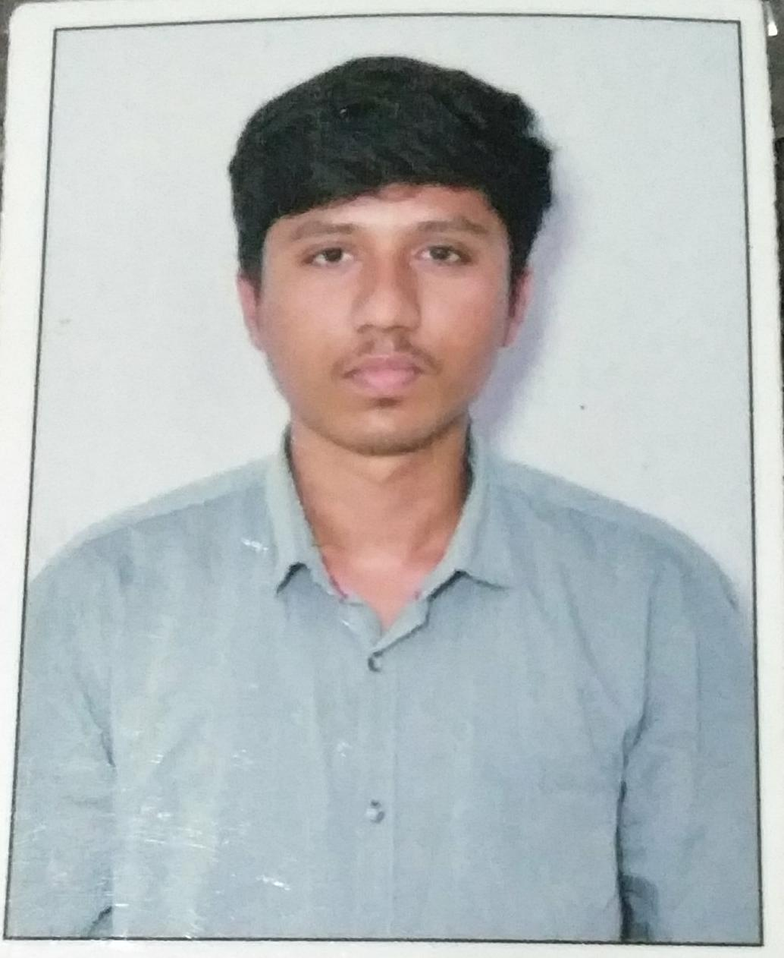
Name of the team: YieldVision
Details of Team members
TEAM MEMBER NAME | Recent Passport Photo | Email ID | Phone number [WhatsApp]
Shrilakshmi C Badiger |  | shrilakshmic@kssem.edu.in | 8217048057
Vamshi Krishna C |  | vamshikrishnac@kssem.edu.in | 84311 61251
Akash S |  | akashs@kssem.edu.in | 6360848864

Slide 3
Problem statement
The Problem: Farming "Blind" in a Changing World
⚠️ The "Why" Gap: Farmers know when they lose a crop, but they rarely know why. Was it the temperature spike in Month 2? Or the soil pH shift in Month 3? Without identifying the root cause, they are doomed to repeat the same mistakes.
🧩 The Data Maze: Critical clues are scattered everywhere—soil health cards, weather apps, market websites, and historical notebooks. It is humanly impossible for a farmer to mentally connect these thousands of data points to find patterns.
📉 Intuition is Failing: "Grandfather’s knowledge" no longer works. Climate change has rewritten the rules. Relying on intuition instead of data is no longer farming; it is gambling.
💸 The Consequence: High input costs + Unpredictable yields = Financial Instability. Farmers need a tool to turn hindsight into foresight.

Slide 4
Proposed solution
Title: Meet YieldVision: The "Digital Agronomy Team"
The Core Concept: We didn't just build a Chabot; we built an Agentic Workflow that mimics a team of human experts working in unison.
🕵️ Agent 1: The "Detective" (Yield Forensics):
  Role: Ingests raw historical data (soil, inputs, harvest logs).
  Task: Uses IBM Granite to find hidden correlations (e.g., "Yield dropped 15% when Potassium was < 20kg").
  Outcome: Solves the "Mystery" of past failures.

Slide 5
Proposed solution
🌐 Agent 2: Live Research (The Scout)
Connects to the live web via SearchAPI to fetch current 2026 weather forecasts, market rates, and pest alerts.
Value: Ensures advice is based on today's reality, not outdated training data.
📋 Agent 3: Strategic Planning (The Planner)
Synthesizes historical lessons with real-time data to generate a specific Action Plan.
Value: Delivers a complete sowing-to-harvest schedule tailored to the farm.

Slide 6
Need of project
💰 Economic Security Shifts farmers from "survival mode" to profit-oriented farming by removing costly guesswork from their decisions.
⛅ Climate Resilience Provides instant, real-time advice to handle sudden weather changes, replacing outdated "generational knowledge."
🤝 Equality in Technology Brings enterprise-level data science to small-scale farmers via a simple, accessible chat interface, leveling the playing field.

Slide 7
End user of project
Who Benefits from YieldVision?
👨‍🌾 Small-Holder Farmers (The Decision Makers) Gains access to enterprise-grade yield forensics on a simple smartphone, enabling expert-level planning without expensive consultants.
🔬 Researchers & Students (The Analysts) Transforms weeks of manual data compilation into instant analysis, acting as a Rapid Research Assistant for regional trend studies.
📋 Field Officers / Krishi Mitras (The Advisors) Empowers local advisors to validate their recommendations with scientific data proof, helping them build trust and drive faster adoption of modern practices.

Slide 8
Technology Used
1.Orchestration: Langflow (Visual Chain Building).
2.LLM Model: IBM Granite (ibm-granite-3-2-8b).
3.Live Web Data: SearchAPI (Google Search Integration).
4.Data Processing: Parse Data Component (Cleaning unstructured web text).
5.Infrastructure: IBM Cloud & Watsonx.ai.

Slide 9
Novelty and Uniqueness
Beyond the Chatbot: True Agentic Innovation
Causal Forensics (The "Why") Moves beyond generic farming tips to identify specific root causes of yield failure, correlating historical weather/input data to final harvest outcomes.
Live Web Awareness (The "Now") Overcomes AI training cut-offs by connecting to the live web via SearchAPI, fetching current 2026 weather, market rates, and pest alerts.
Granite-Guarded Reliability (The "Trust") Built specifically on IBM Granite to minimize "hallucinations," ensuring bias-free, regulation-compliant, and safe advice for critical livelihood decisions.
·

Slide 10
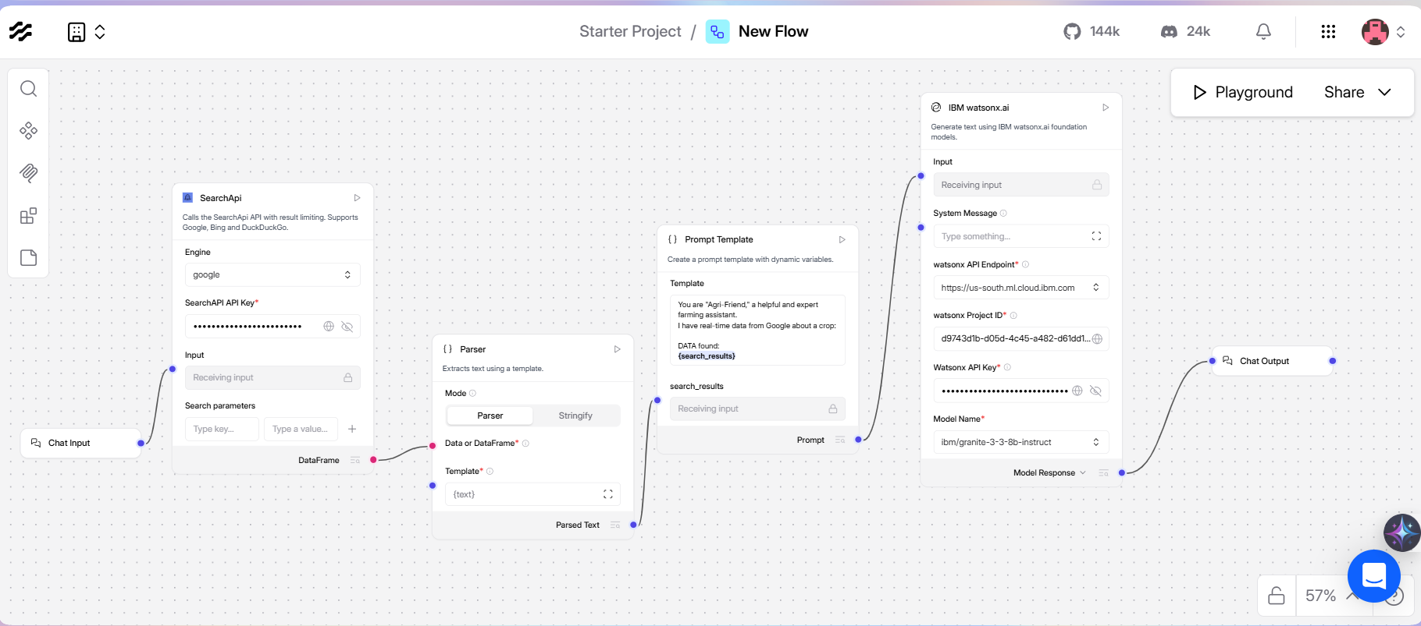
Technical flow diagram - Architecture blueprint

Slide 11
Langflow component Used
Chat Input – The interface where the farmer enters natural language queries (e.g., "Why did my cotton yield drop?") or instructions for the agent.
IBM Watsonx AI Agent – The "Brain" of the system. It uses the IBM Granite-3.2-8b model to synthesize the uploaded historical data with live web research to generate the final advice.
File Component – Critical for Yield Analysis: Allows farmers to upload historical farm records (CSV/Excel/PDF) so the agent can analyze past trends and establish a yield baseline.

Slide 12
Langflow component Used
Chat Output – Displays the final, structured Yield Analysis Report and Farm Action Plan to the user in a readable format.
SearchAPI & Parse Data (Custom Tools) –
  SearchAPI: Fetches live 2026 weather and market data.
  Parse Data: Cleans unstructured web text (removes HTML/Ads) to ensure the AI analyzes only high-quality information.

Slide 13
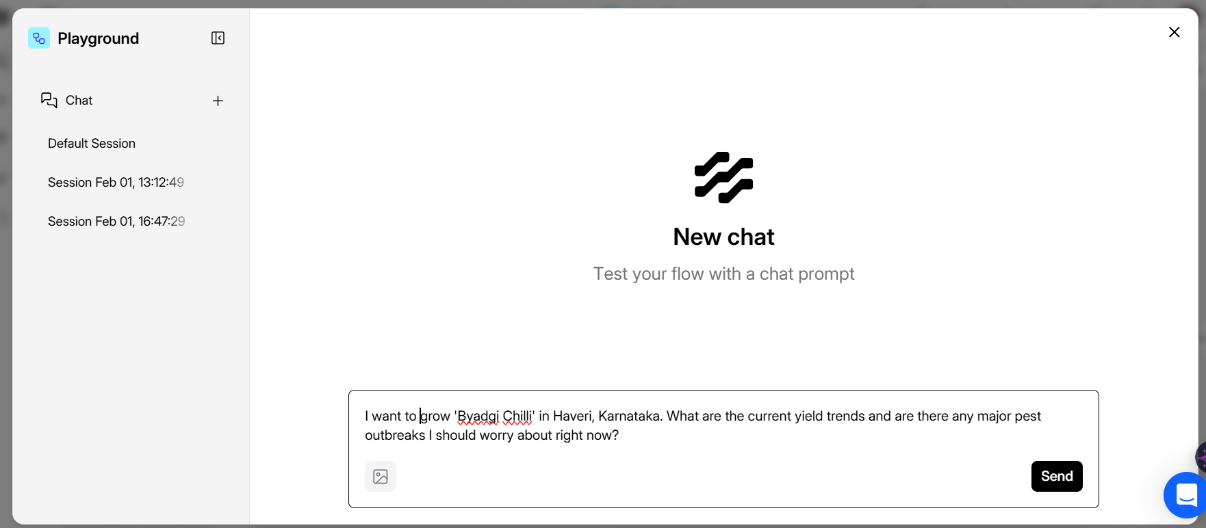
Input Screenshot 1 : Case 1

Slide 14
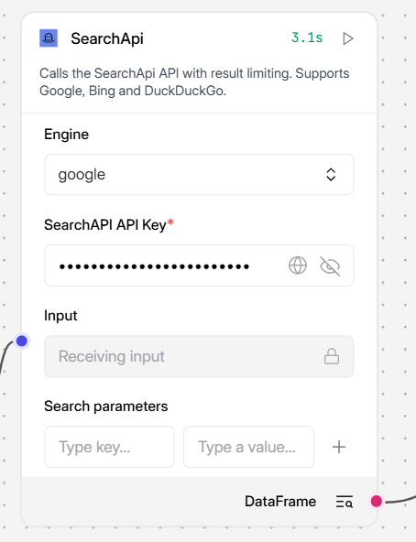
Input Screenshot 2

Slide 15
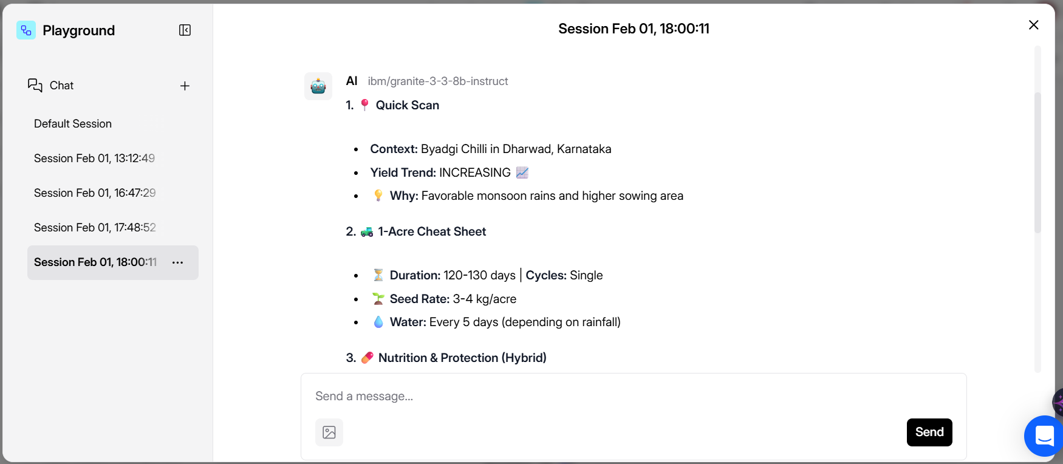
Output Screenshot 1

Slide 16
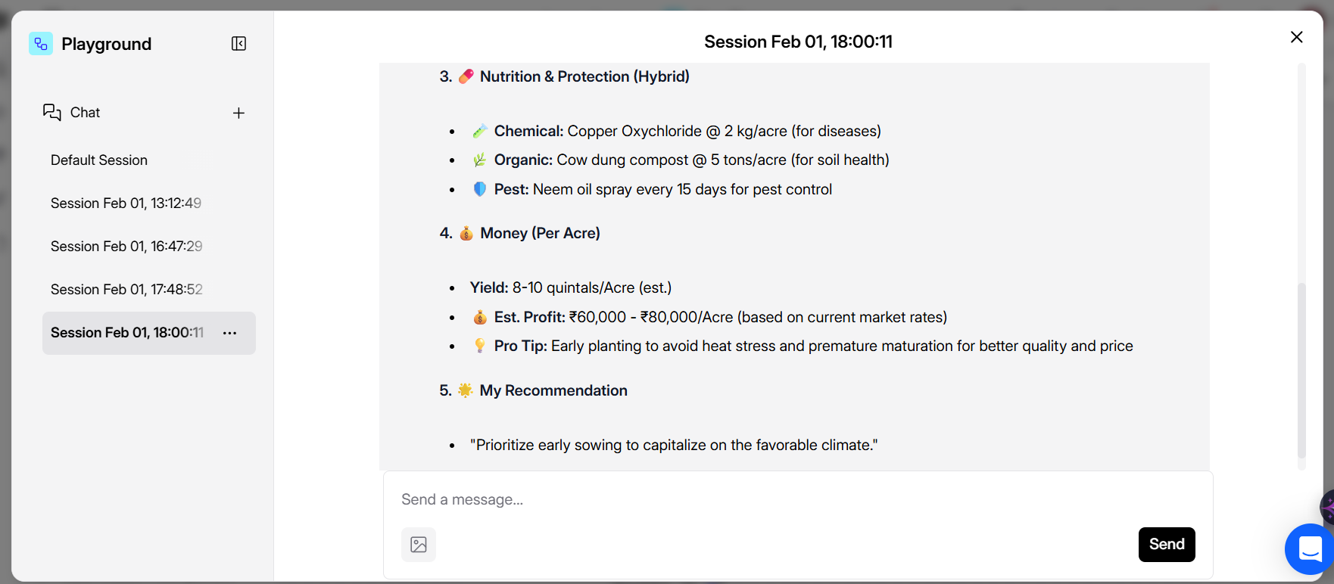
Output Screenshot 2

Slide 17
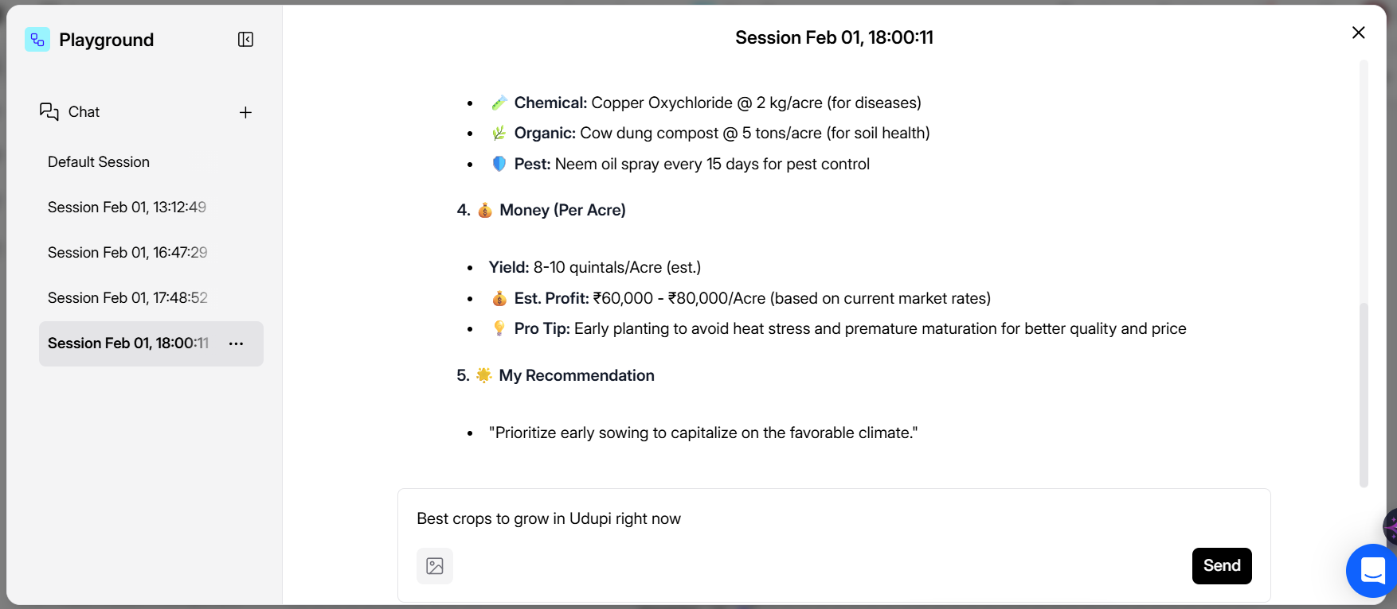
Input Screenshot 1: Case 2

Slide 18
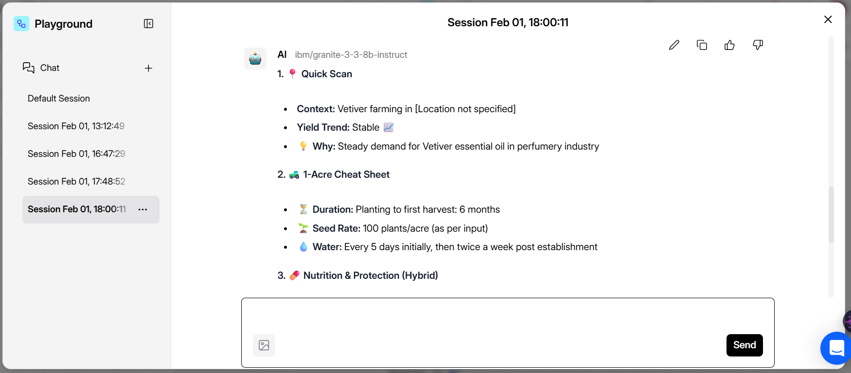
Output Screenshot 1

Slide 19
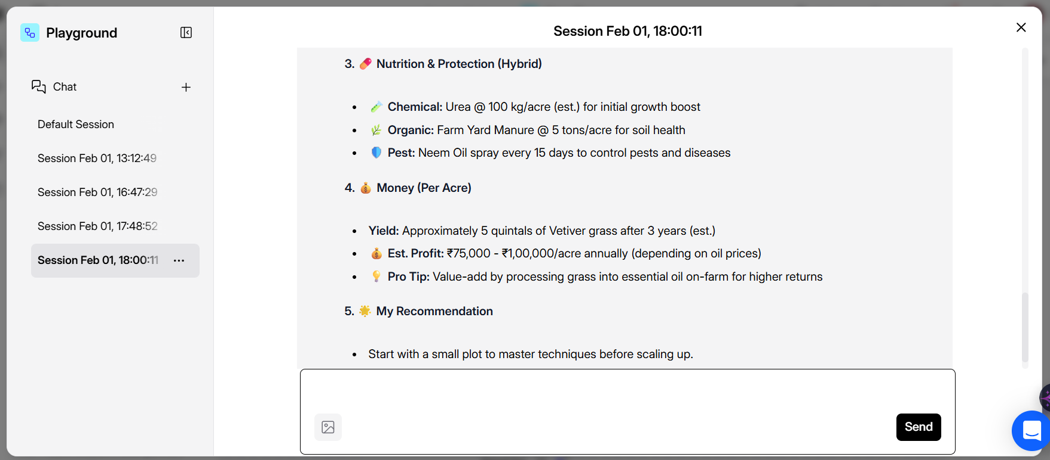
Output Screenshot 2

Slide 20
Future Scope
AI "Leaf Doctor" (Computer Vision Integration)
The Feature: Allow farmers to upload photos of crop leaves.
The Goal: Instant disease diagnosis and pest detection using image recognition models, linked directly to yield impact predictions.
Voice-First Interface (Accessibility)
The Feature: Full Speech-to-Text and Text-to-Speech support.
The Goal: Break the literacy barrier. Farmers can simply talk to YieldVision in their native dialect instead of typing.
·

Slide 21
Future Scope
Hyper-Localization (Multilingual Support)
The Feature: Deploying models for regional languages (Kannada, Hindi, Tamil, Telugu).
The Goal: Ensure that high-level data science is accessible to the grassroots farmer in the language they trust.

Slide 22
Git Hub Link
https://github.com/Shree282005/Agri-Bot

Slide 23
References
IBM Watsonx Documentation: https://www.ibm.com/products/watsonx-ai
Langflow Official Docs: https://docs.langflow.org/
SearchAPI Real-Time Engine: https://www.searchapi.io/
Edunet Foundation & IBM SkillsBuild: https://skillsbuild.org/

Slide 24
Thank you!
Thank you for your time and interest.

